Slide 1
2020 Census
Ambassador Training

Slide 2
Why you’re here
A Census Ambassador is a trusted messenger who has the knowledge to educate their community about the census and its impact on our city.
As a Census Champion, you will be part of a team making our community better for the next ten years.

Slide 3
What you will learn
What the Census is and why it’s important
How the Census will work
How to complete a 2020 Census form
How Census responses are kept confidential
How to educate and motivate our neighbors to respond
How to work for the 2020 Census

Slide 4
Census 101

Slide 5
Census 101
Mandated by the U.S. Constitution
A national survey conducted every ten years by the U.S. Census Bureau (Not City Government)
Counts every person living in the United States on April 1, 2020
Counts PEOPLE not CITIZENS
This year’s Census is SHORT FORM ONLY - 9 questions

Slide 6
Why care about the Census?
The Census is more than just a head count
An accurate census gets Chattanooga a decades worth of
The right number of representatives in government
Federal funding for education, health care, housing, veterans, seniors, highway construction, and services like emergency response and fire departments
On average we lose $1,091 for every person not counted
Understanding of and support for our community
Notes:
The more people we count, the more representation we get
Census data is used for research and trends - impacts where busineses open, where hopsitals will go, where schools will be built

Slide 7
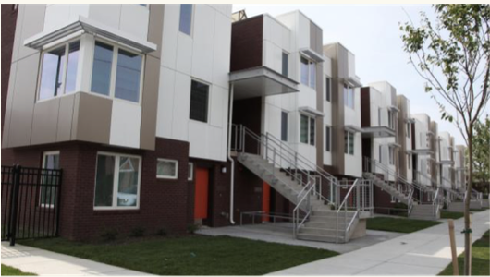
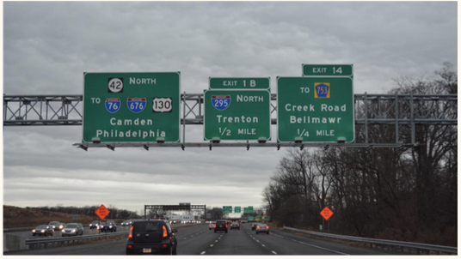
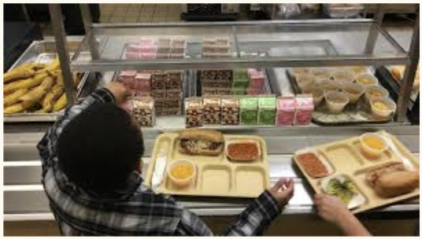
Federal programs determined by Census Count
Federal school funding
School lunch programs
Headstart seats
Medicaid (Tenncare)
Medicare
SNAP (food stamps)
Highway funding
Section 8 housing vouchers
Federal student aid

Slide 8
How people use Census Data
Federal programs disperse grants that support communities based on population totals and breakdowns by sex, age, race
Businesses use Census Bureau data to decide where to open new stores, factories, and offices
Local governments use census data to ensure public safety, plan new schools and hospitals, draw city council districts, and plan public transit and roads
Nonprofits use census data to learn about community needs and make the case for grant funding
Neighborhoods and activists use census data to identify community issues and advocate for them

Slide 9
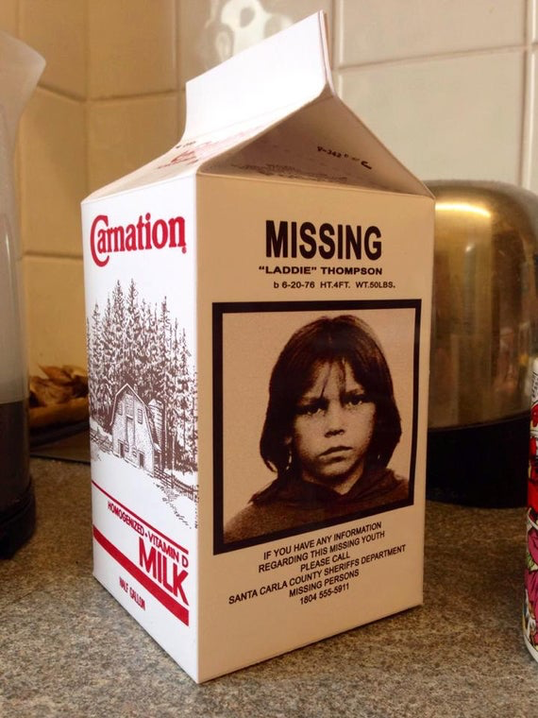
Undercounting
An undercount is when fewer than the actual number of people are recorded in the final Census count.
An undercount means federal programs and representation are allocated for a small number of people than actually live in our City.
On average only about 75% of people in Chattanooga self-respond to the Census
Don’t get counted = Lose power

Slide 10
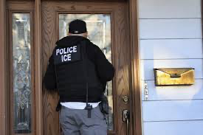
Who is hard to count?
Hard to Interview Language barriers, low literacy, lack of internet access
Hard to Locate Housing units not in our frame, persons wanting to remain hidden
Hard to Contact Highly mobile, homeless, physical access barriers
Hard to Persuade Suspicious of the government, low levels of civic engagement

Slide 11
Who is hard to count?
Young children
Highly mobile persons (Homeless)
Racial and ethnic minorities
Non-English speakers
Low income persons
Undocumented immigrants
Persons who distrust the government
LGBTQ persons
Persons with mental or physical disabilities
Persons who do not live in traditional housing

Slide 12
How the Census Works

Slide 13
Types of Counts
Household - related individuals who live together
(house, apartment, etc)
Includes transitory people - counted at hotels, motels, campgrounds using a paper form
People are invited to self-respond
Enumerators follow-up with households that have not yet completed or have incomplete census

Slide 14
Types of Counts
2. Group Quarters - unrelated individuals who live together (nursing home, correctional facility, college dorm, homeless shelter)
Get counted by the operator of that facility or Census Bureau staff
Do not count incarcerated on your census form
Do not count parents, grandparents in nursing homes on your census form
Do not count children living at college
Do not count people in shelters, community kitchen, living unsheltered on your census form

Slide 15
Where you count
Count everyone who is living in the household on April 1, 2020
Usual residence = the place where the person lives and sleeps most of the time
Notes:
15 minutes

Slide 16
Pop Quiz
We live off-base, but my husband Aaron is on his second tour in Afghanistan
How is Aaron counted?
As living in military barracks in Afghanistan during Group Quarters

Slide 17
Pop Quiz
Our first child, Augostino was born on April 1, 2020. We took him home from the hospital on April 3rd.
How is Augostino counted?
By his parents at their place of residence

Slide 18
Pop Quiz
Penelope is my partner and she moved into my house on April 1, 2020. She still owns her home in Knoxville, but rents it out.
How is Penelope counted?
As a partner in your household because that’s where she lives on April 1

Slide 19
Pop Quiz
My husband and I equally share custody of our 3 year old daughter Eva.
How is Eva counted?
At the house where Eva is at on April 1, 2020.

Slide 20
Pop Quiz
Our 20 year old son James resides at Univesity of Memphis dormitory during the school year.
Where is James counted?
At University of Memphis during Group Quarters Count
Notes:
15 minutes

Slide 21
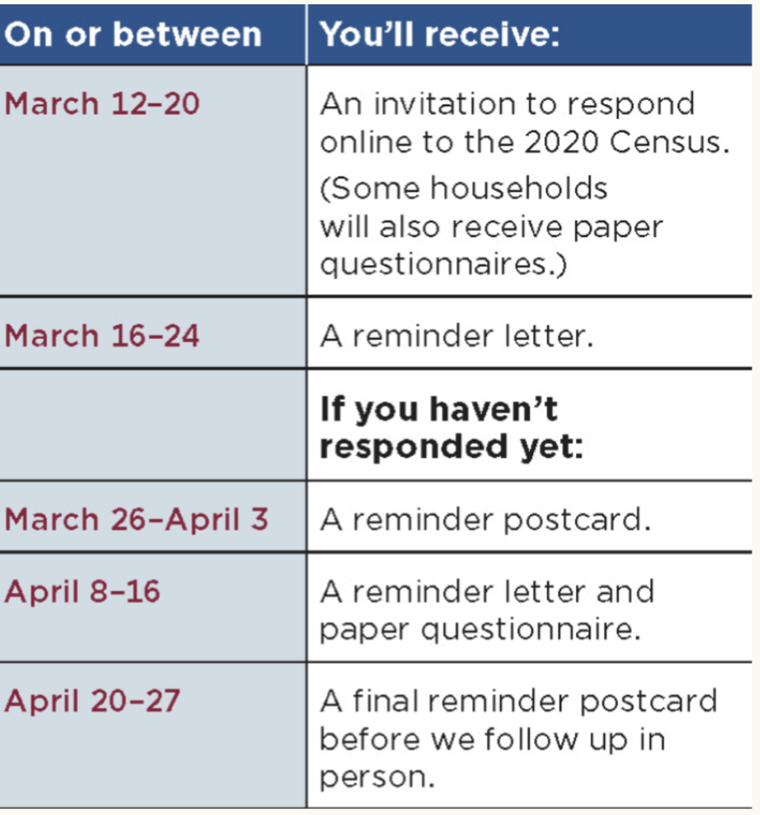
How the Census Invites people to respond
some households will also receive paper questionnaires Check Here

Slide 22
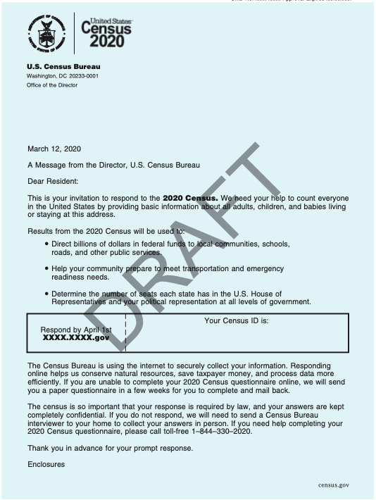
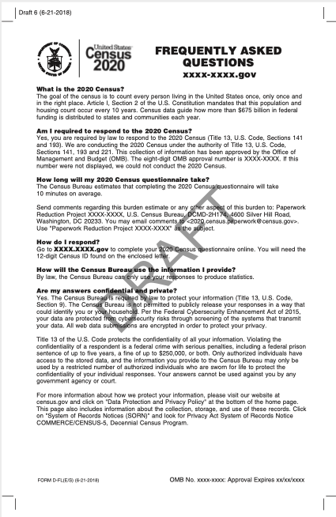

Slide 23
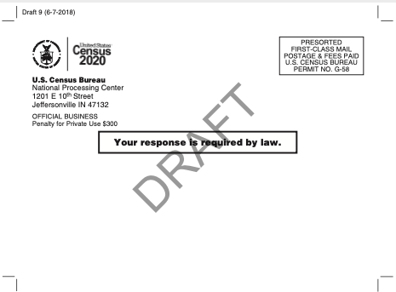
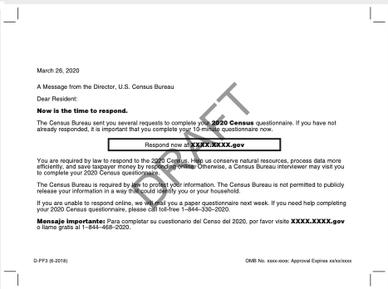

Slide 24
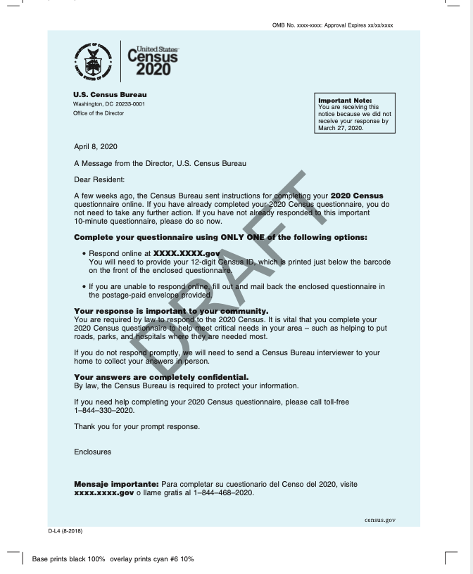

Slide 25
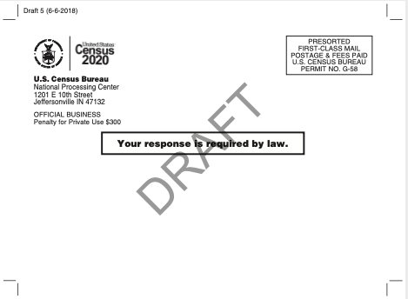
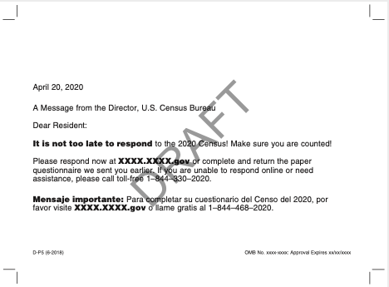

Slide 26
How to respond

Slide 27
How to respond
Four Ways to Respond
1. Online (NEW)
2. Phone
3. Paper form via U.S. Mail
4. In Person
Census Takers visit households who do not complete the Census online, by mail, or by phone

Slide 28
Language Barriers - Complete Online or By Phone
In addition to English, people can respond to the census online or by phone in 12 different languages:
Spanish
Chinese
Vietnamese
Korean
Russian
Arabic
Tagalog
Polish
French
Haitian Creole
Portuguese
Japanese
The paper form will be available in English and bilingual English-Spanish

Slide 29
Help people get counted

Slide 30
Help people get counted
People can respond to the Census using any computer
They can also respond using a smartphone or tablet
If you have computers in your facility, have them available for walk-ins to complete their Census, we can help with signage to identify your location as a place people can go to complete their census
EASY GUIDE FOR PEOPLE WITH LITTLE TO NO COMPUTER EXPERIENCE

Slide 31
Helping people respond
By Federal Law - only US Census Bureau workers can help residents respond to the Census
If someone needs help (other than navigating to the Census site)
Contact the U.S. Census Bureau
Print a language guide that walks through step by step

Slide 32
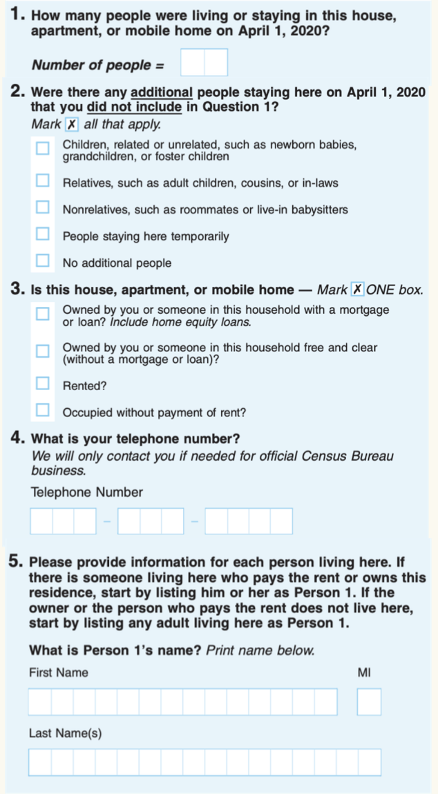
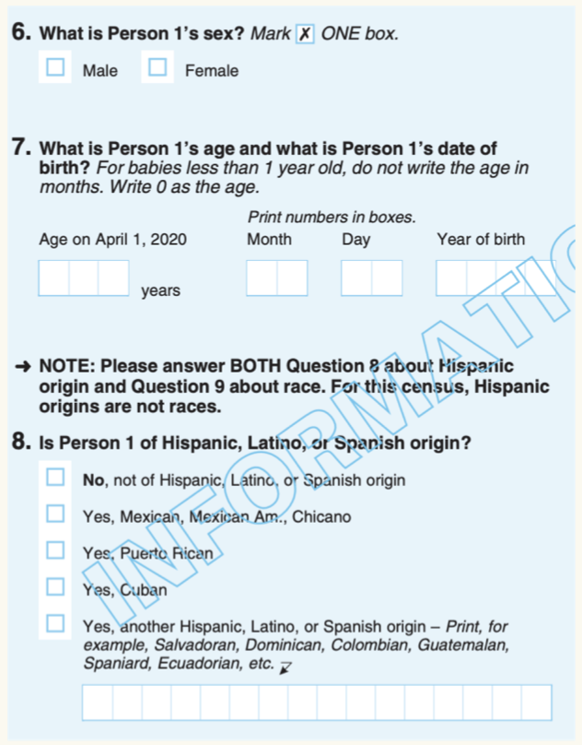
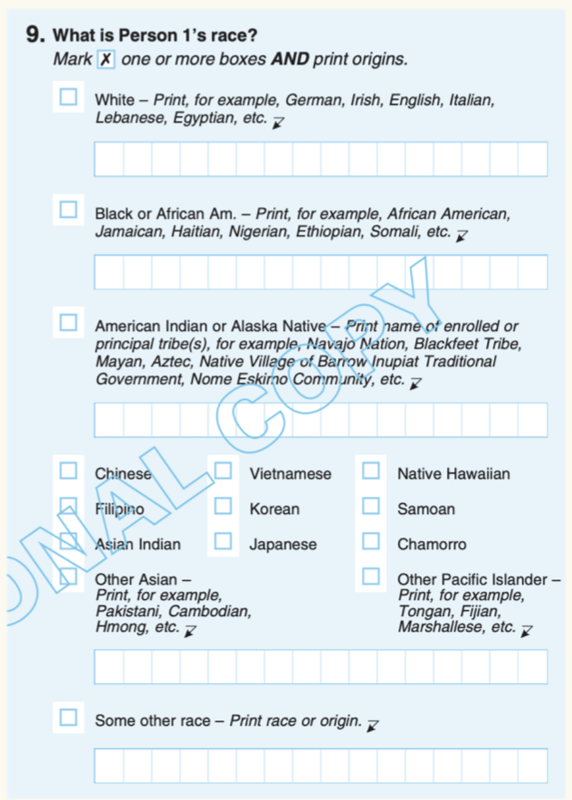

Slide 33
Do I have to answer all the questions?

Slide 34
Yes
Everyone should fill out the Census completely
If you do not answer all the questions your form can still be submitted, but..
An enumerator may come by to your house to collect the missing information

Slide 35
Confidentiality

Slide 36
Confidentiality
Responses are protected by federal law under Title 13
By law your census response CANNOT be used against you by any government agency, court, or law enforcement including
FBI
ICE
CIA
Department of Homeland Security
Census Bureau workers take a lifetime oath of non-disclosure to protect your answers
Your answers can only be used to produce statistics
All data online is encrypted to protect personal privacy

Slide 37
Will there be a citizenship question on the 2020 census?

Slide 38
NO

Slide 39
How is the data used?
Census data can only be used for statistical purposes
The census data is protected by federal law
NO ONE CAN ACCESS INDIVIDUAL RESPONSES
The U.S. government will not release identifiable information about an individual to any other individual agency until 72 years after it was collected.
1940 Census records were released on April 2, 2012

Slide 40
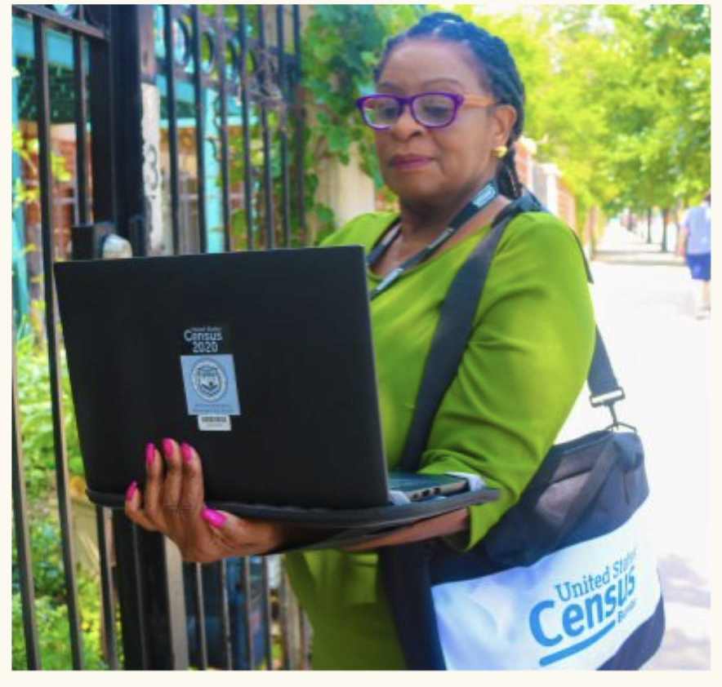
How can I recognize a census worker?
All U.S. Census Bureau workers will have badges and briefcases indicating their affiliation with the U.S. Census Bureau
Employees will introduce themselves as a Census Bureau employee and show their official government ID badge
The U.S. Census Bureau will never ask you to step out of your home.
When in doubt verify at https://www.census.gov/cgi-bin/main/email.cgi

Slide 41
Tips for Avoiding Census Scams
Census Bureau will ask for your phone number
The Census Bureau will NEVER ask for your:
social security number
Money or donations
Credit card number or bank information
The Census will never send an invitation to complete the census via email
To report a scam
Call 1-800-262-4236

Slide 42
Your Role

Slide 43
How we ensure everyone gets counted in Chattanooga
Base the way you engage with people based on how they normally interact with you and your organization
In-person
Print
Digital
Phone
Face-to-face conversations are crucial to educate and engage community member
Proactively educate the community with signs, information sessions, or impromptu conversations
Be a resource for people who need help
Convince people that the Census is important
Motivate people to respond

Slide 44
Messaging that works -
CIVIC DUTY
We need to count every person in Chattanooga
To get funding for our community’s needs
To let decision makers know where we are.
To make our voices heard and get representation
Because the census is our civic duty

Slide 45
Messaging that works - RESOURCES
Every person not counted in the census is a loss of $10,910 over 10 years in our community
Neighborhoods in need should get the resources they deserve
Being counted enables us to have political representation
We must hold on to the representation we currently have

Slide 46
Messaging that works - FUTURE
The census helps determine the future of our community for the next ten years
Completing the census is a way to ensure a brighter future for our children and community, the more people that are counted - the better our future will be
It is up to ALL of us to create a better future for Chattanooga!

Slide 47
Practice
Pick a partner
Partner 1 - make up a persona and pretend to be that person
Partner 2 - make your pitch to that person about the 2020 Census
Switch!

Slide 48
Working for the Census
Temporary work
Hiring process is 100% online - people must apply for jobs online, complete their hiring process online, and complete online training
Must by at least 18 years old, have a valid Social Security number
Some non-citizens will be allowed to work in areas where there is a high demand
Census takers are assigned based on the zip code where they live
2020census.gov/jobs
1-855-JOB-2020

Slide 49
5 Easy Ways to Be a Census Champion Right Now
Text CHA CENSUS to 97779 and tell everyone you know to do the same
Go to connect.chattanooga.gov/census2020 and pledge to get counted
Host an event on Census Day April 1, 2020 to reach out to the people you serve and spread awareness about the census
Post Census posters and materials in your office and in public high traffic areas
Work with your department, organization, group to make a plan to make sure everyone you serve gets counted

Slide 50
Resources
Tyler Yount
Director of Special Projects
tyount@chattanooga.gov
Brooke Satterfield
Project Coordinator
bsatterfield@chattanooga.gov
connect.chattanooga.gov/census2020
Pledge to get counted
Learn about the Census
Get resources and printable outreach materials
Join the Complete Count Committee

